Slide 1
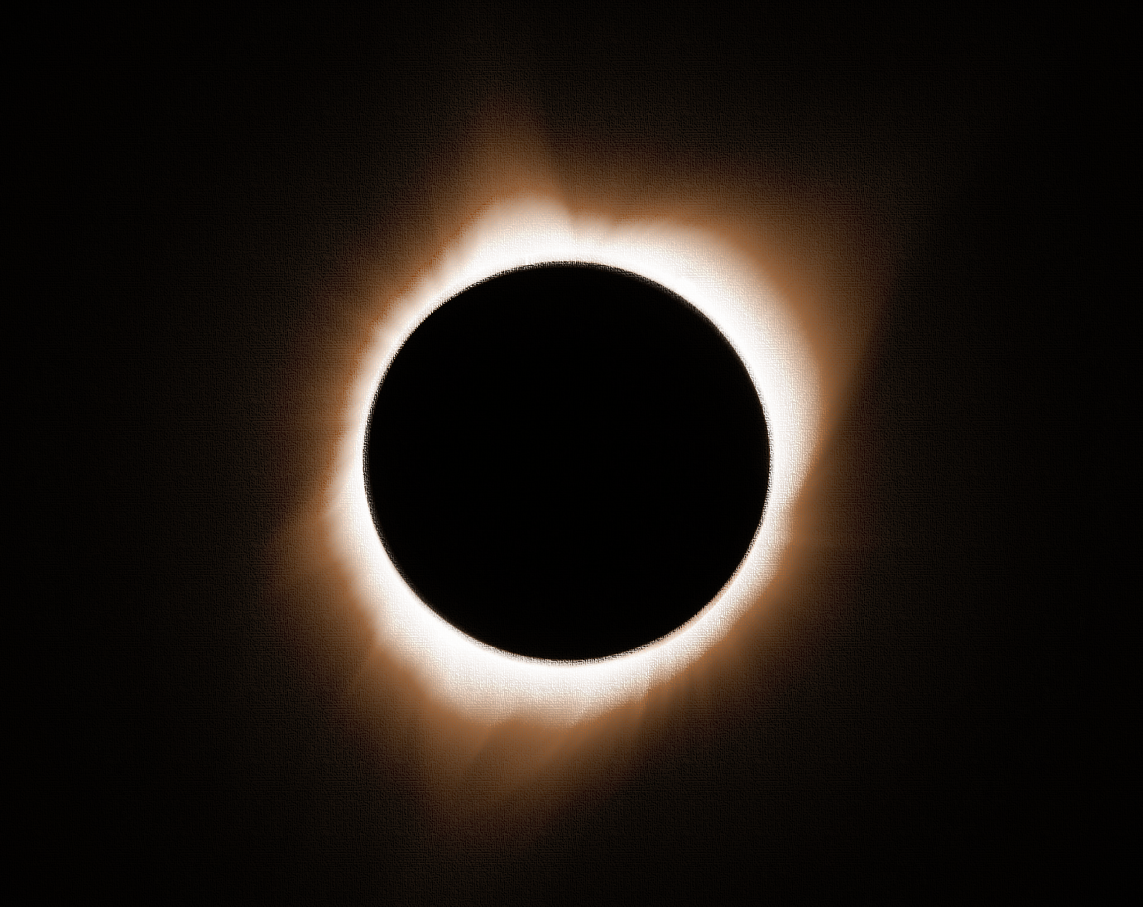
On the Relativity of Magnitudes
Delboeuf’s forgotten contribution to the 19th Century problem of space

Slide 2
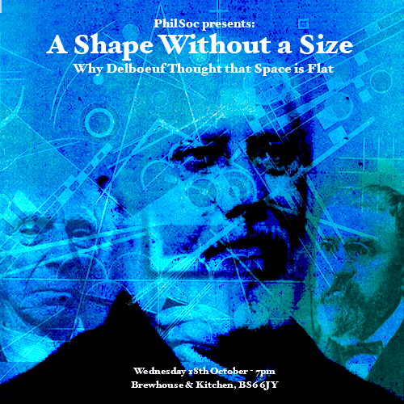
Alternative title contenders:
“A Shape without a Size”
“Flat Space II: Return of the Similar”

Slide 3
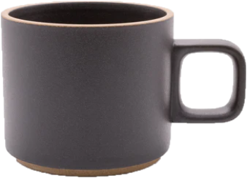
Consider a mug
Shape is absolute, size is relative

Slide 4
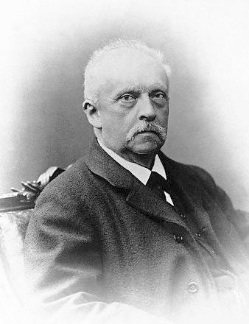
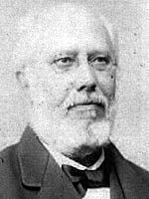
Contents
Problem: Discovery of non-Euclidean geometries
First strategy: The mobility of rigid figures
Second strategy: The relativity of magnitudes
Comparison & discussion
Applications to physics
Basic Dialectic (19th century)
“Metageometry”— vs —“Euclidean apriorism”

Slide 5
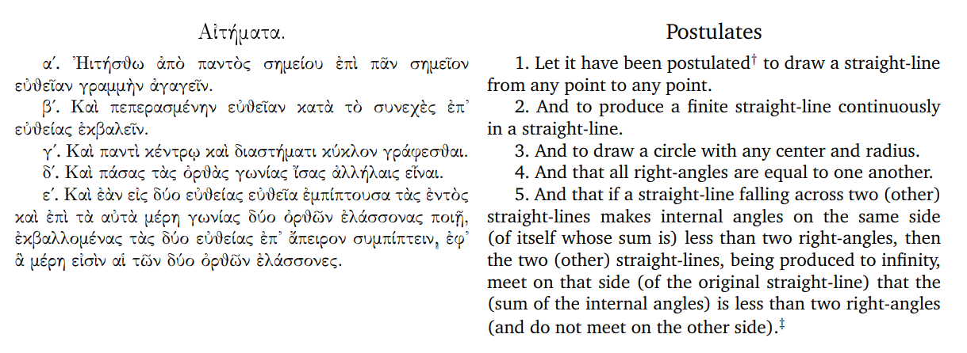
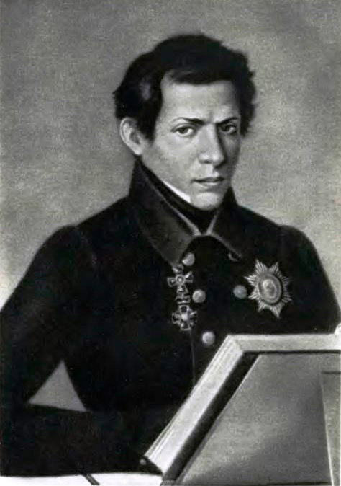
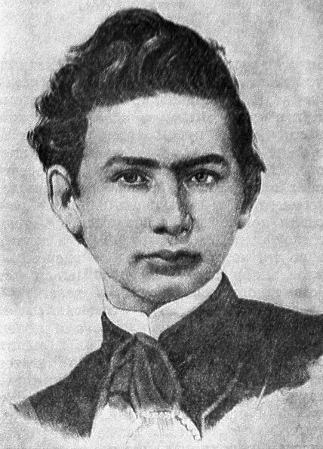
1. The Problem
Over the centuries Euclid’s fifth postulate has caused endless controversy.
Early in the 19th Century, Lobachevsky and Bolyai independently discover a self-consistent system of geometry based on the denial of the parallel postulate.

Slide 6

Non-euclidean geometries
Triangle’s angle sum <180
Triangle’s angle sum >180

Slide 7
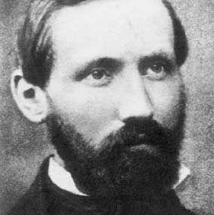
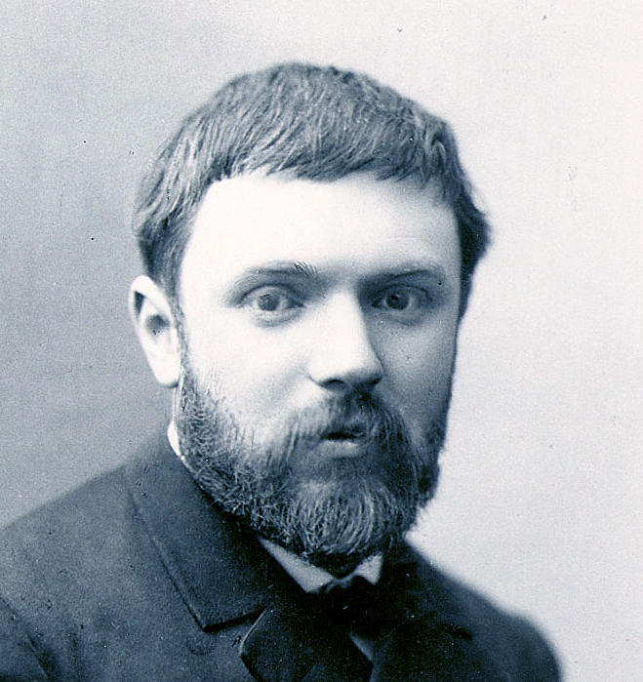
2. First Strategy: Mobility of rigid bodies

Slide 8
2.1 Mobility - Riemann
Landmark paper “On the hypotheses which lie at the basis of geometry” (1854)
  “Measuring involves the superposition of the quantities to be compared”
Two hypotheses proposed:
  “the length of lines is independent of their configuration” → General Riemannian geometries
  But if bodies are independent of their configuration, Riemann writes: “it follows that the curvature is everywhere constant, and the angle sum in all triangles is determined if it is known in one”

Slide 9
2.2 Mobility - Helmholtz
Helmholtz (1866 & 1870) further develops this notion of the mobility of rigid bodies.
  “all proof by Euclid’s method consists in establishing congruence”
However, Helmholtz also recognises that ideal rigid figures are never given in experience.
Ends second essay with a somewhat Neo-Kantian view.

Slide 10
2.3 Mobility - Poincare
Concerning Riemann’s geometries of changing curvature, he writes:
  “most of these definitions are incompatible with the motion of a rigid figure, [...] These geometries of Riemann, in many ways so interesting, could never therefore be other than purely analytic and would not lend themselves to demonstrations analogous to those of Euclid.”
For Poincare therefore, geometries of changing curvature would undermine the very aim of mathematics, which is inductive generalisation.

Slide 11
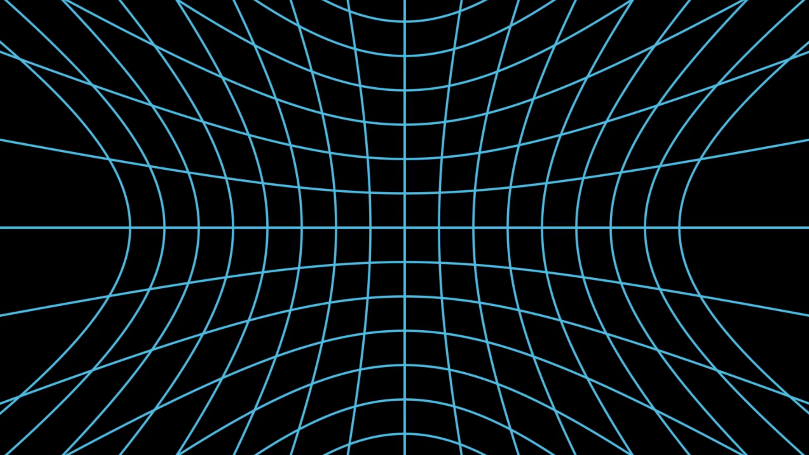
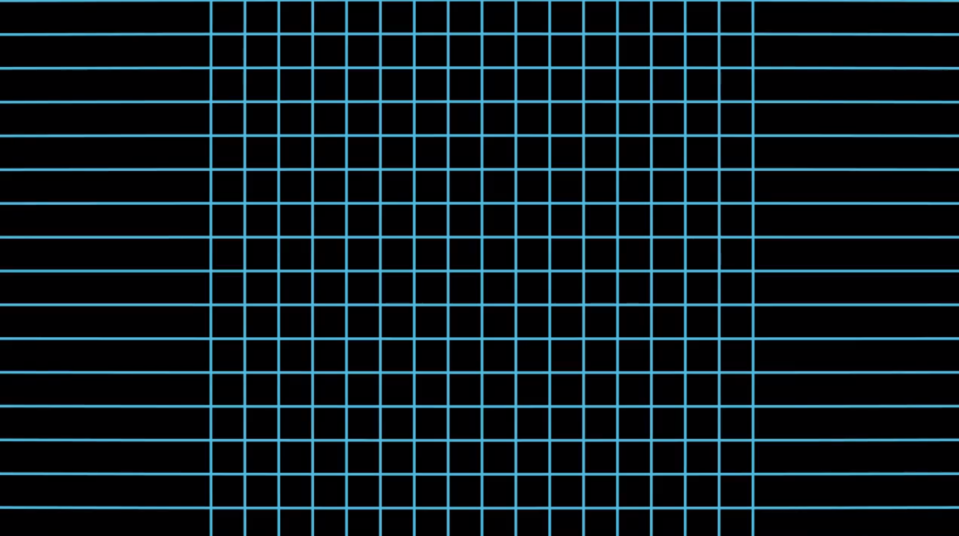
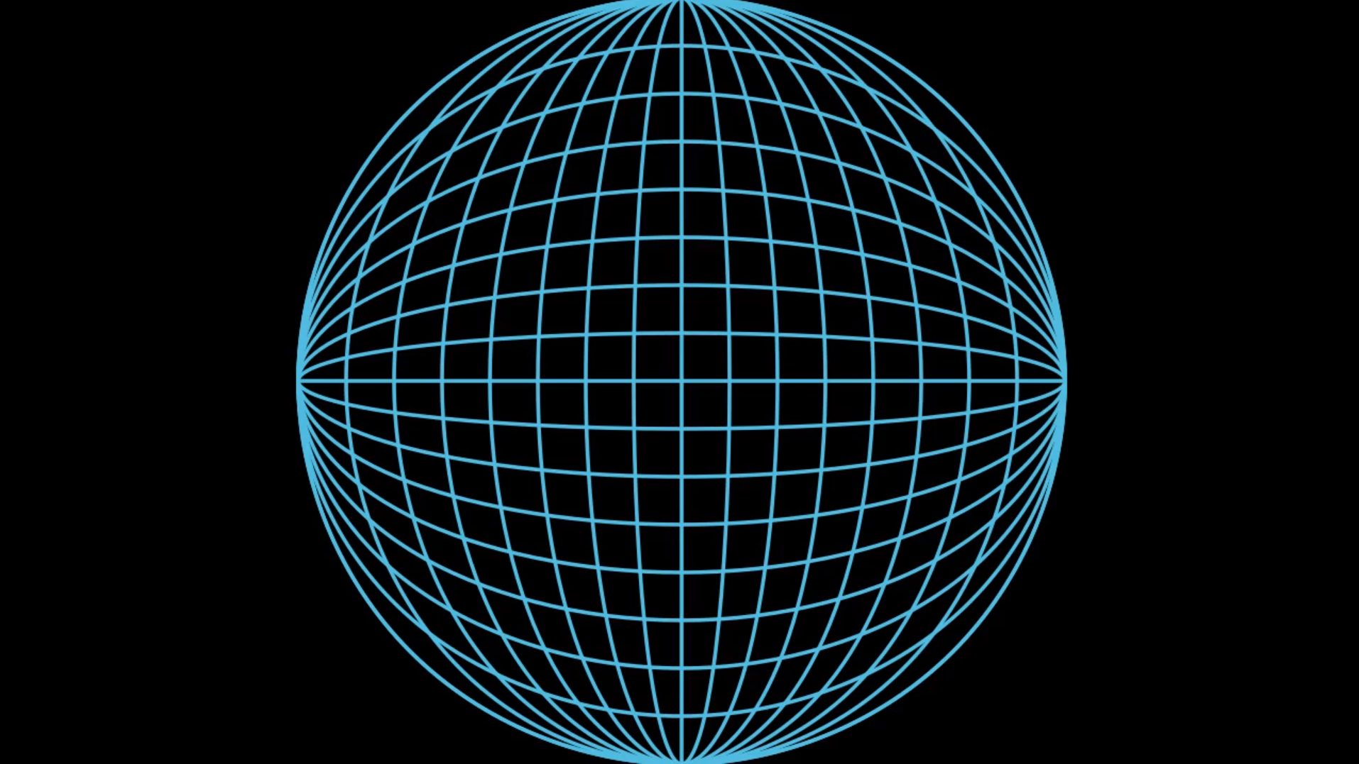
Conclusion of first strategy:
The mobility of rigid figures implies that geometry is of constant curvature:
  Hyperbolic
  Euclidean
  Spherical

Slide 12
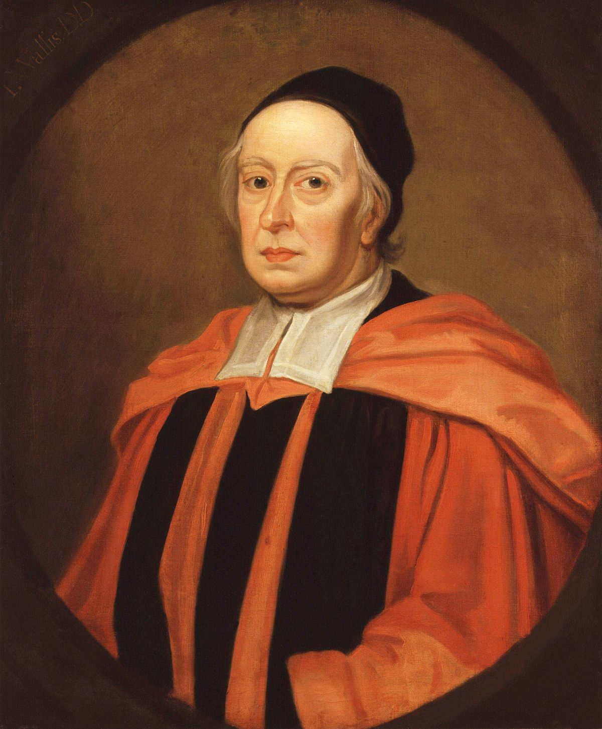
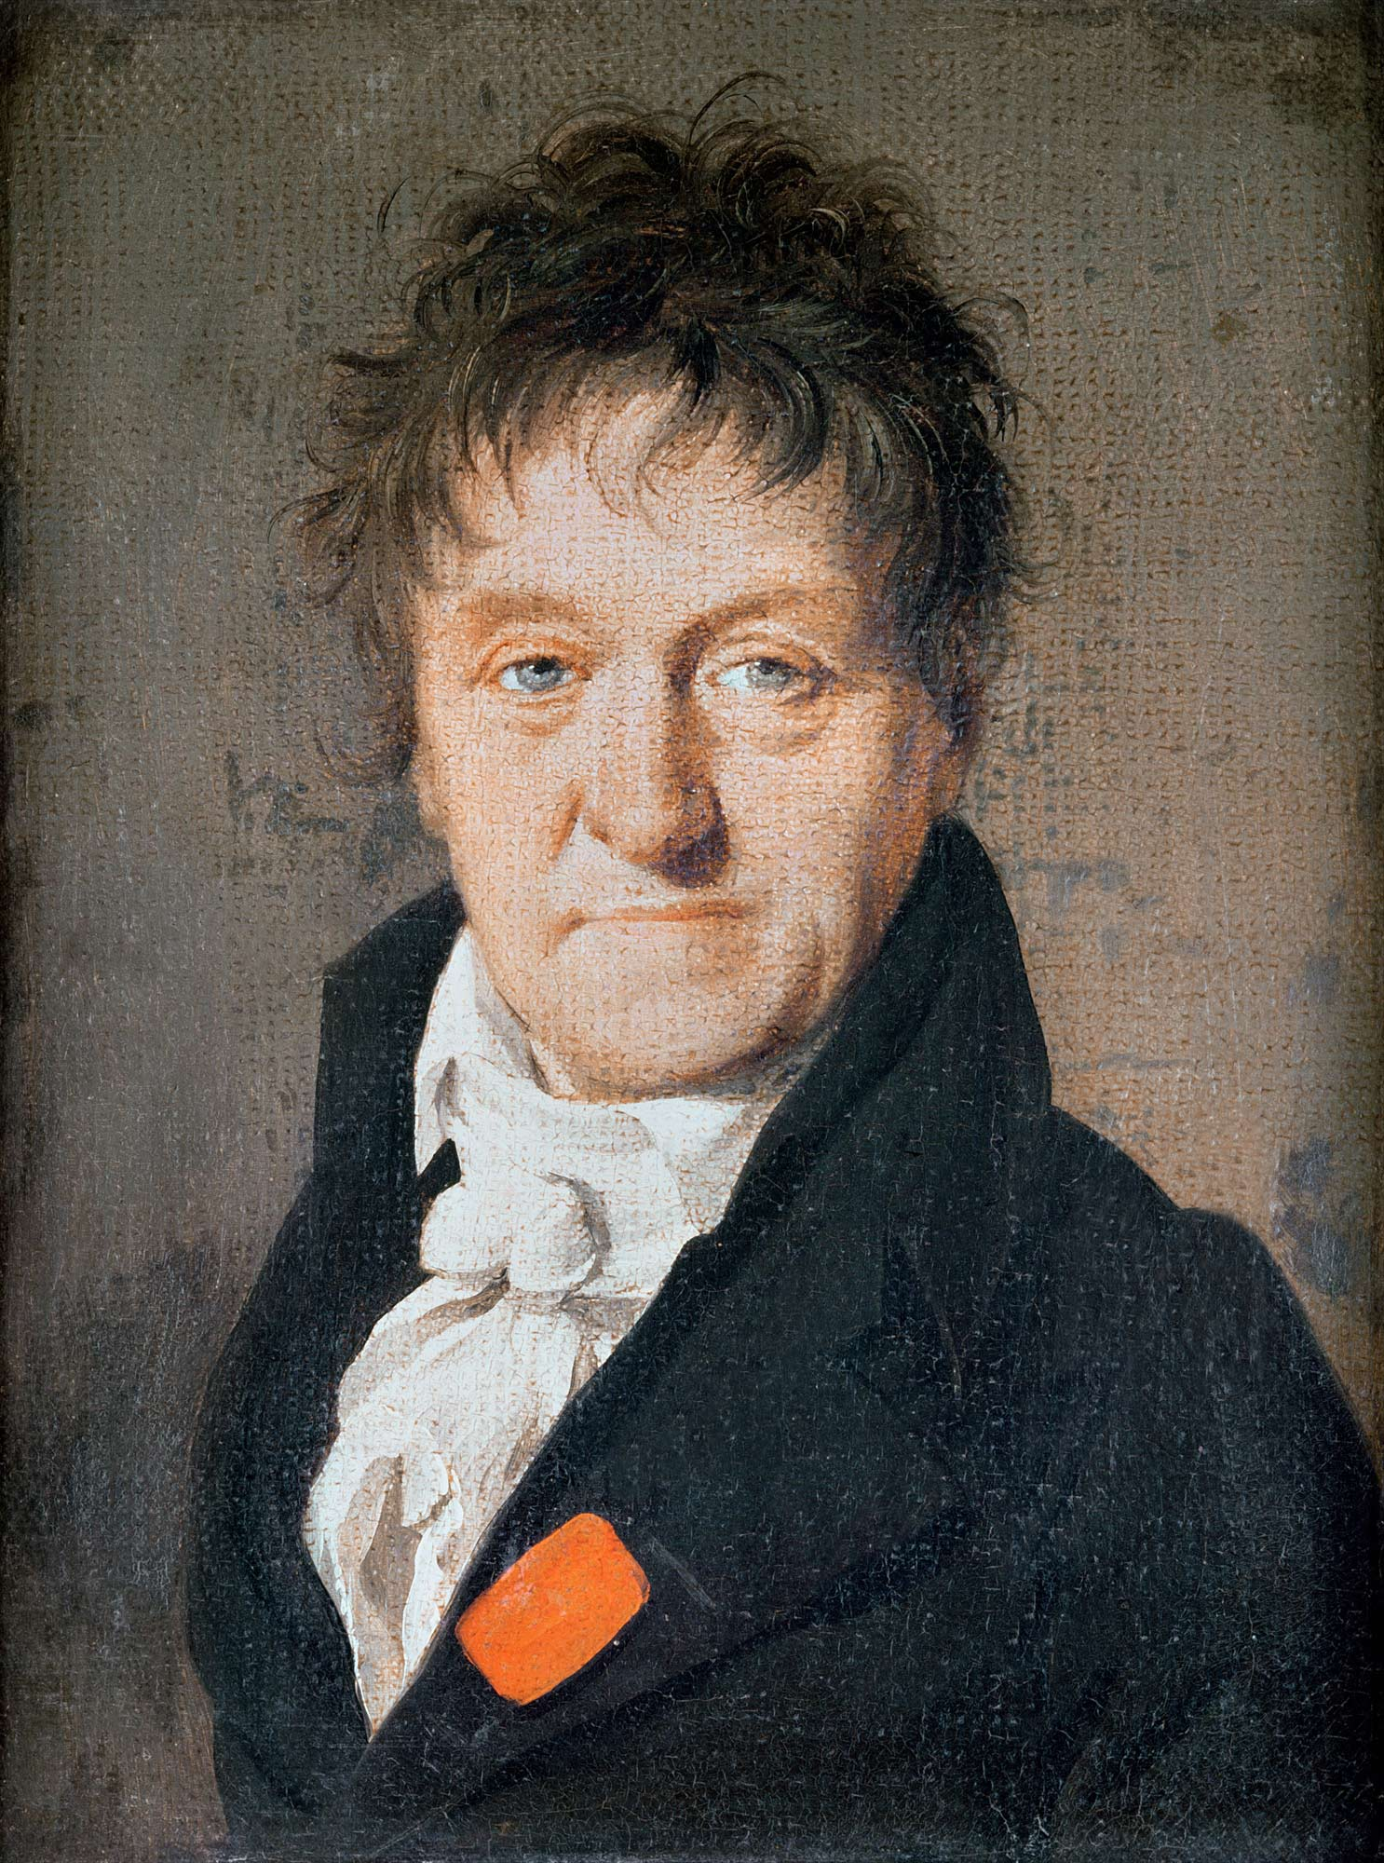
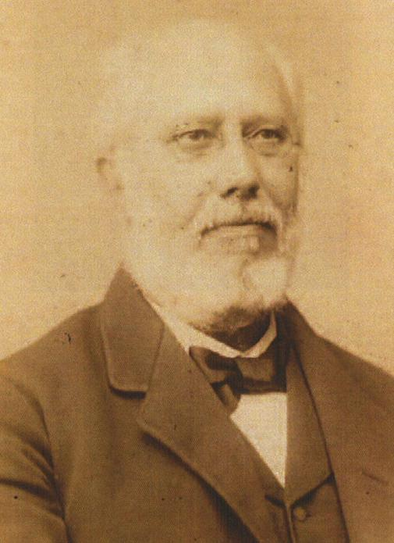
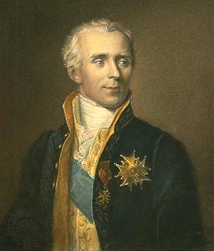
3. Second Strategy: The Relativity of magnitudes

Slide 13
Other criteria?
Unlike all other geometries:
  Euclidean geometry is similar to itself at different scales.
In terms of figures:
  Euclidean geometry allows for the possibility of similar figures.

Slide 14
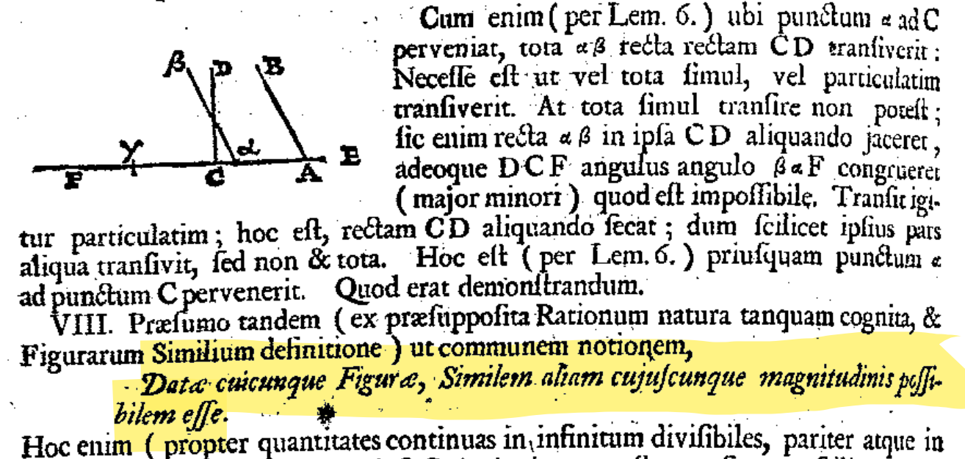
3.1 John Wallis (1663)
The postulate of the parallels is identical to the possibility of constructing similar figures.
Transformations by similarity are necessary due to the reciprocal independence of shape and size.
Since shape is a quality and size is a quantity, they must vary independently.

Slide 15
3.2 Carnot and Laplace
Carnot (1803)
  “The theory of parallels depends on a more primary notion which appears to me to be of the same order of clarity as that of the perfect equality or superposition of figures; this is the notion of similarity. […] This notion once admitted, it is easy to establish the theory of parallels, without recourse to the notion of infinity.”
Laplace (1825)
  “The idea of a limited extension, for example of the circle, contains nothing which depends on its absolute size. But, if we diminish, by thought, its radius, we are inevitably inclined to diminish in the same ratio its circumference and the sides of all the figures inscribed. This proportionality appears to be a much more natural postulate than that of Euclid.”

Slide 16
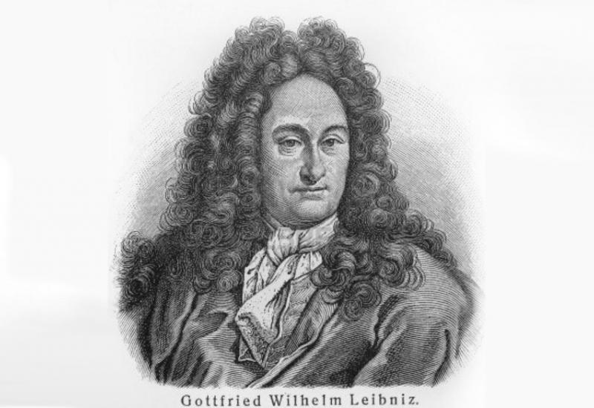
3.3. Delboeuf (1860)
Elevates Wallis’s postulate to “first postulate of geometry”
Proof that there is a single straight between two points involves the notion of the homogeneity of space
Homogeneity, or self-similarity is the “genetic characteristic” of:
  Space
  The plane
  The straight line
Interestingly, Leibniz had used the same criterion to define the plane and the line:
  “The only self-similar loci are the straight line, the plane, and space itself.” (see Uniformis Locus, translated by De Risi)
This definition of the straight automatically excludes non-Euclidean geodesics: (see animation)

Slide 17
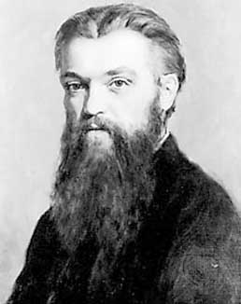
3.3. Delboeuf (1860)
Delboeuf goes on to derive all of the fundamental postulates of Euclidean geometry from this basic notion of self-similarity
We can compare this to Clifford’s axiomatization of geometry in Postulates of the Science of Space (1873):
  Continuity
  Infinitesimal flatness
  Superposition (mobility of rigid figures, i.e. constant curvature)
  Zero curvature (this one is rejected by Lobachevsky)
For Delboeuf however, all of these postulates are already contained in the single concept of homogeneity.

Slide 18
3.3 Generating Parallels
The final challenge for Delboeuf was to find a ground for the theory of parallels.
Delboeuf again uses similarity transformations.
This method automatically excludes notions of parallels in hyperbolic geometry.

Slide 19
3.3 Delboeuf’s philosophical aims
The bulk of the book is in fact philosophical, concerns an attempt to reconcile realism and idealism.
  Experience presents us with a world of difference, change, inhomogeneity
  The mind seeks to find unity within these phenomena, to make generalisations.
Of the mind Delboeuf says
  “we see in intelligence simply a synthetic force which tends towards unity, towards the uniformization (if we can risk this word) of phenomena. She feels a need to transform the varied world of perceptions into a universe of conceptions; accidental, fortuitous relationships, into general laws, true everywhere and always […]”
The concept of space, characterised by its homogeneity, is an expression of our mind’s attempt to bring unity to experience

Slide 20
4. Comparison
& Reflections

Slide 21
4.1 Comparison of the two strategies
Helmholtz’s empiricist method involves the physical movement of bodies with respect to one another.
  This can only tell us about the properties of a relative space; a space defined by relations to bodies.
Delboeuf’s method involves ideal motions which are not physically realisable.
  This method is appropriate for the determination of the properties of space itself, abstracted from all physical relations, in the Kantian sense.
  Does not rely on the existence of solids.

Slide 22
Two geometries?
Delboeuf 1860:
  “There is therefore, [...] a double geometry. The first strives, given a natural form, to bring it back to an ideal form; [...] this empirical geometry studies bodies or phenomena independently of their substance [...]. The second, theoretical geometry, follows an inverse course, and, starting from ideal, absolute principles, creates an infinity of forms and seeks to make them coincide with natural forms.”
Revisiting the topic in 1894 Delboeuf also emphasises that the empirical space is one of changing curvature:
  “This [real space] certainly has a curvature, but this curvature is different at each of its points and varies there at each instant.”

Slide 23
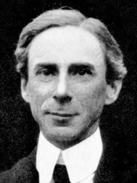
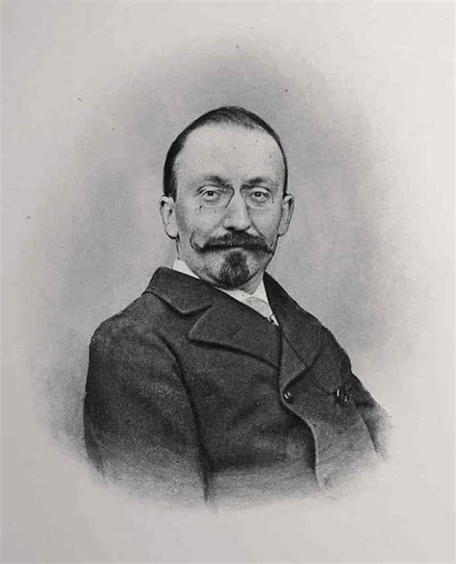
Russell’s first objection
In Russell’s book “Foundations of Geometry” (1897)
  Claims space is relative and passive
  Yet endorses spaces of constant curvature.
Couturat (1898) calls him out:
  Russell’s arguments should imply that space is Euclidean, on account of the relativity of magnitudes.
  "Can you maintain that [space] is the amorphous, passive receptacle of every possible figure if you can neither construct the same figure on diverse scales, nor enlarge it without deforming it, as if space reacted upon it in the manner of a rigid form?”
Russell
Couturat

Slide 24
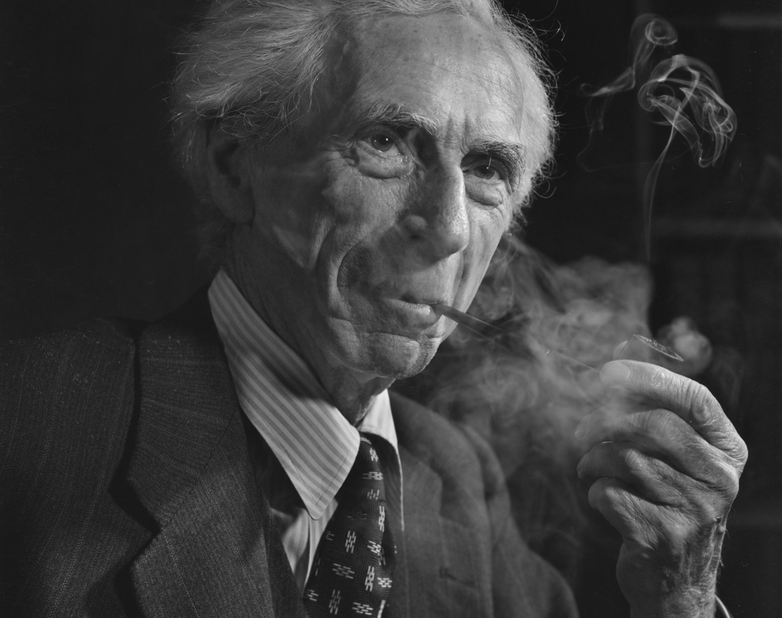


Russell’s relative angles objection!
Russell’s “refutation” (1898):
  "Those who affirm it to be evident a priori that the sides of a triangle can be lengthened in a given ratio without altering the angles, ought to hold, it seems to me, that it is equally possible to alter all the angles in a given ratio without altering the sides.”
Delboeuf died in 1896; Couturat became friends with Russell and failed to call him out.
We can respond ourselves:
  It is not angles that should be relative, but directions.
  Angles are absolute just as ratios between magnitudes are absolute.

Slide 25
5. Applications to Physics
Bimetric theories:
The physical/geometrical distinction had formerly been proposed by Riemann (1853):
  “I seek the cause [of gravity] in the state of motion of the continuous substance spread throughout the entire infinite space. [...] this substance may be thought of as a physical space whose points move in geometrical space.”
Presently, a persistent minority of physicists endorse a return to flat space for methodological reasons:
  Recovering energy conservation.
  Consistency with methods in particle physics.
  Quantum gravity.
  Mach’s principle.
These physicists usually draw upon Poincare’s ideas (geometrical convetionalism), Delboeuf may be more appropriate.
Scale-invariant cosmology:
If we refuse to accept the existence of epistemically inaccessible absolutes, then, since the universe as a whole possesses no external reference, it is a shape without a size.
  This notion is central to Julian Barbour’s Shape Dynamics.
  It is also relevant to Sloan and Gryb’s scale invariant cosmologies
Again, Sloan and Gryb quote Poincare to justify this idea, but in fact Poincare was only paraphrasing Delboeuf.

Slide 26
Conclusions
In mathematics:
  The starting point of geometry is the notion of a homogeneous space (i.e. scale-invariant or self-similar), rather than that of an amorphous manifold lacking geometry.
  The general theory of curved geometries (Riemannian geometries) is secondary to the original space concept.
  Curved spaces are not space itself – they are particular forms or shapes in space.
In physics:
  A relative or contingent space – which may have properties physical and can be non-Euclidean
  Absolute space – which is Euclidean (i.e. flat).
In cosmology:
  The universe as a whole, has no external reference, it is a shape without a size, therefore it must live in Euclidean space.

Slide 27
Fin

Slide 28
Key references
Delboeuf (1860) "Prolegomenes philosophiques de la geometrie"
Wallis (1663) - see Hill (1925)
Riemann (1854) "On the hypotheses that lie at the foundations of geometry"
Helmholtz (1870) "On the Origin and Meaning of Geometrical Axioms"
Poincaré (1902) "Science and Hypothesis"
Couturat (1898) “Review of Russell: On the Foundations of Geometry”
Laplace (1825) "Systeme du Monde" (2nd ed.)
Carnot (1803) "Geometrie de Position"
Russell (1898) “Are Euclid’s axioms Empirical?”
Jonathan Fay,
UoB, Department of Philosophy
hi20625@bristol.ac.uk
relativemotion.org

