Slide 1
Delboeuf’s forgotten defence of Euclidean geometry
Jonathan Fay, 04/03/2026

Slide 2
What are space and time?
According to Schopenhauer — they are just what is needed to represent causation.
  Space enables coexistence
  Time enables change
  Only in their union can we have causation
  Causation is presupposed a priori, prior to investigation.
  It’s that simple — that is why we live in space and time.

Slide 3
Plan
Against his contemporaries, Joseph Delboeuf defended Euclidean “apriorism” based on methodological (not empirical) considerations.
Contents:
  Background on fifth postulate
  Canonical strategy:
    Riemann
    Helmholtz
    Poincaré
  Alternative strategy:
    John Wallis
    Joseph Delboeuf
  Russell’s objections
  Final remarks

Slide 4
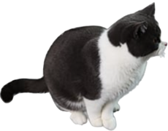

Slide 5
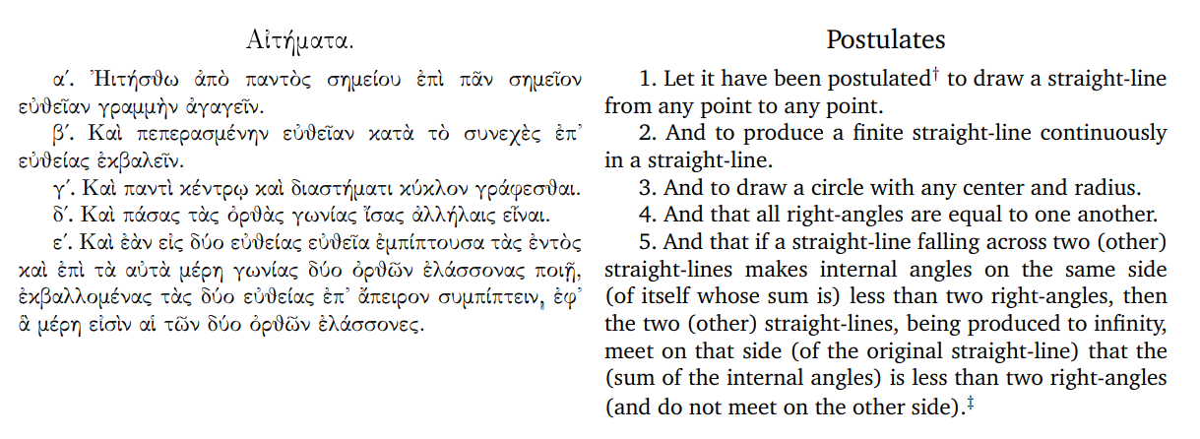
Euclid’s fifth

Slide 6
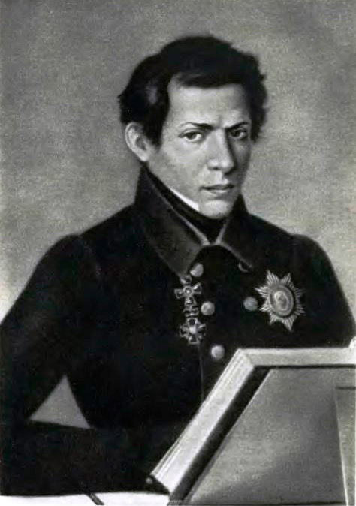
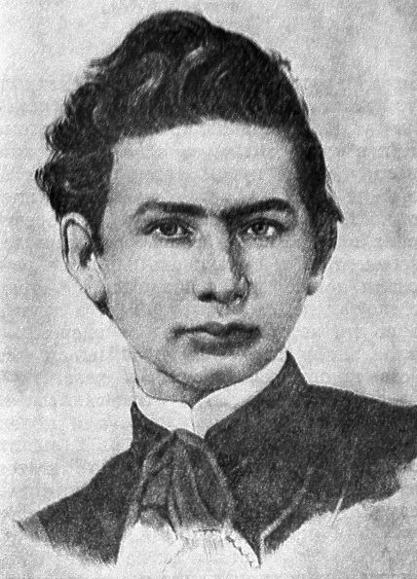
Neo-geometers
In the 1820s:
Lobachevsky and Bolyai independently discover that you can reject postulate 5 in a self-consistent way and construct a self-consistent system of geometry.

Slide 7

Non-Euclidean geometries
Triangle’s angle sum <180
Triangle’s angle sum >180

Slide 8
Epistemology of geometry
The canonical account
We will cover:
  Riemann
  Helmholtz
  Poincaré
Empiricist—Neo-Kantian approach characteristic of the era.

Slide 9
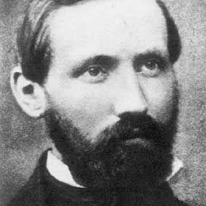
Canonical strategy
Riemann
By the mid century this was generating substantial interest in the epistemology of geometry.
Riemann “On the hypotheses which lie at the basis of geometry” (1852):
  Measuring involves the superposition of quantities to be compared
  This implies that in order for a quantity of length to have a meaningful value, it needs to be movable.
    If lengths are independent of configuration —> general Riemannian geometries
    If bodies (shapes) are —> constant curvature geometries

Slide 10
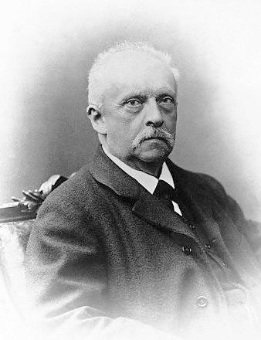
Canonical strategy
Helmholtz
Helmholtz (1866, 1870), develops notion of mobility of rigid bodies further.
  He considers it necessary that rigid bodies be movable —> constant curvature
  Adopts a somewhat Kantian view — since rigid bodies might not be actually given in experience.
  First instance of clearly articulated geometrical conventionalism (I think).

Slide 11
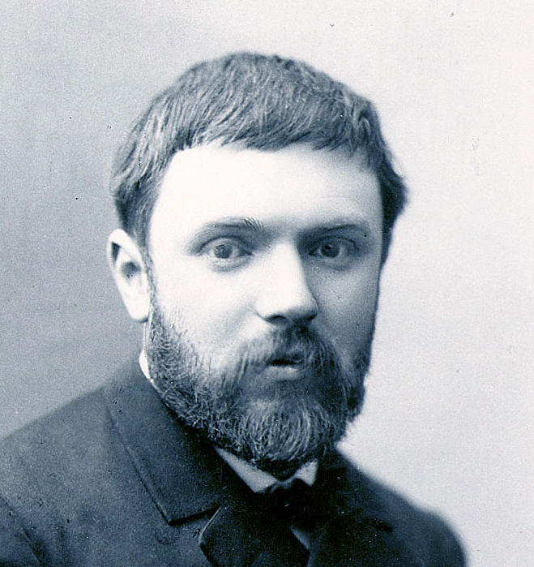
Canonical strategy
Poincaré
Poincaré “Non-Euclidean geometries” (1891):
  “most of these definitions are incompatible with the motion of a rigid figure, [...] These geometries of Riemann, in many ways so interesting, could never therefore be other than purely analytic and would not lend themselves to demonstrations analogous to those of Euclid.”
  For Poincare, geometries of changing curvature would undermine the very aim of mathematics, which is inductive generalisation.

Slide 12
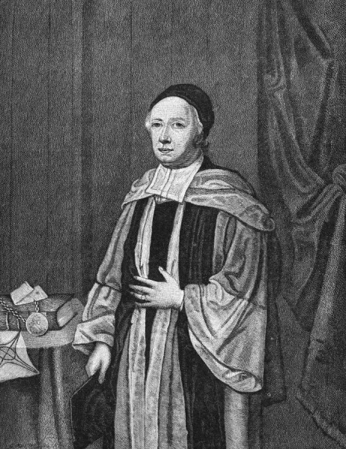
Alternative strategy
Relativity of magnitudes
Is there something else which sets Euclidean geometry apart from those of non0zero curvature?
  Yes, — the relativity of scale.
John Wallis, in 1663, seems to be the first person to have spotted this, he makes a metaphysical argument:
  Shape and size are two different metaphysical categories and so must be allowed to vary independently
  This implies the possibility of transformations by similarity, which replaces the parallel postulate of Euclid.

Slide 13
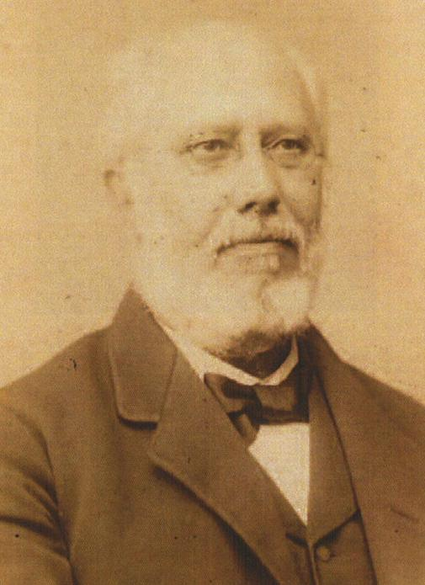
Joseph Delboeuf
1
Belgian philosopher-mathematician-psychologist
In 1860, write an entire book rediscovering Wallis’s idea.
“Homogeneity” or self-similarity is the “genetic characteristic” of: space, the plane, the straight line.
In fact if you define a straight line in this way you are already presupposing that space is Euclidean

Slide 14
Joseph Delboeuf
2
  Elevates Wallis’s postulate to the “first postulate of geometry”
  We can compare this to Clifford’s axiomatization of geometry in “Postulates of the Science of Space” (1873):
    Continuity
    Infinitesimal flatness
    Superposition (mobility of rigid figures, i.e. constant curvature)
    Zero curvature (this one is rejected by Lobachevsky)
  All of these are already presupposed in the single concept of “homogeneity”

Slide 15
Joseph Delboeuf
3
Philosophical stance
Complains that the apriorism of Kant, and others
  “to explain the apodicticity of the geometric laws, the way in which they impose themselves on us as necessary, these philosophers make them the laws of our nature, the innate properties of our soul, the forms of our sensitivity, of our relationships with things, without telling us why it is that precisely the ideas of geometry are innate to us. In other words, their solution leaves room for a new why.”
But he is not satisfied with the empiricist answer either which would claim that geometry is grounded in facts about the world.

Slide 16
Joseph Delboeuf
3
Philosophical stance
For Delboeuf, the space of experience is in fact not Euclidean at all. Since all manner of causes, such as variations in temperature deform bodies.
No bodies in experience actually conform to mathematical laws, only by abstraction.
Homogeneous space is instead an expression of the method of science, which seeks unity, universality, definiteness in nature; it presupposes these in its inquiry and gives an account of nature only insofar as nature obeys these.
  “She feels a need to transform the varied world of \emph{perceptions} into a universe of conceptions; accidental, fortuitous relationships, into general laws, true everywhere and always; post hoc into propter hoc; changing matter into invariable substance”
This is where our idea of spatial (and temporal) homogeneity comes from, and this is what the axioms of geometry are grounded on.

Slide 17
Russel’s objections
First objection
In his book “Foundations of geometry” (1897)
  Claims that our idea of space is passive, non-dynamical, and so should be of constant curvature, rejects Delboeuf’s idea.
Louis Couturat (1898) calls him out, explaining that:
  "Can you maintain that [space] is the amorphous, passive receptacle of every possible figure if you can neither construct the same figure on diverse scales, nor enlarge it without deforming it, as if space reacted upon it in the manner of a rigid form?” — Couturat endorsed Delboeuf’s view.
  Additionally, Joshua Eisenthal “The absolute motion detector” (2026) has pointed out that a space of constant curvature would also produce tidal forces on a moving body due to geodesic deviation, thus contradicting the relativity of motion.

Slide 18
Russel’s objections
Second objection
Russell (1898)
  "Those who affirm it to be evident a priori that the sides of a triangle can be lengthened in a given ratio without altering the angles, ought to hold, it seems to me, that it is equally possible to alter all the angles in a given ratio without altering the sides.”
This argument is repeated by Poincaré as well as Torretti (1978).
Delboeuf died in 1896; Couturat became friends with Russell and failed to call him out.
We can respond ourselves:
  It is not angles that should be relative, but directions.
  Angles are absolute just as ratios between magnitudes are absolute.

Slide 19
Gravity?
  There are plenty of approaches to gravity in flat space.
  Not difficult — we just interpret “geometrical effects” as universal modifications of bodies; light doesn’t trace straight lines.
  Among other things we recover energy conservation as a methodological principle, reflecting our presupposition of causality.
  The main objection is from Reichenbach — pathology of non-Euclidean topologies.
Cosmology?
  If a concept of the universe is legitimate — a notion of all things, lacking external reference,
  Then the universe is a shape without a size, it ought therefore to live in a homogeneous space.

Slide 20
FIN

Slide 21
All references can be found in my paper:
Fay, J. (2024). On the relativity of magnitudes: Delboeuf’s forgotten contribution to the 19th century problem of space. Studies in History and Philosophy of Science, 106, 165-176.

